Slide 1
Speaking truth – that’ll show ‘em.

Slide 2
Rachel Carson, American marine biologist, conservationist and writer whose book Silent Spring (1962), denounced the indiscriminate use of pesticides, and helped launch the modern environmental movement. “It is a curious situation that the sea, from which life first arose should now be threatened by the activities of one form of that life. But the sea, though changed in a sinister way, will continue to exist; the threat is rather to life itself.” ― Rachel Carson, The Sea Around Us, 1951.

Slide 3
PFOS Per Fluoro Octane Sulfonic acid is an 8-carbon chain variety of PFAS – Per- and Poly Fluoro Alkyl Substances

Slide 4
Icarus and Daedelus

Slide 5
Pandora’s Box

Slide 6
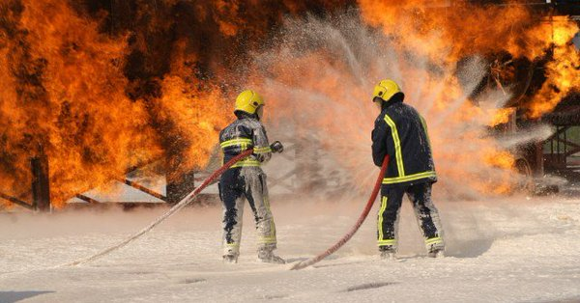

Slide 7
March AFB

Slide 8
1982 – Naval Air Warfare Center

Slide 9
Why would the Air Force release these photos when they knew PFOS/PFOA was found in the groundwater at 700,00 ppt?

Slide 10
Foam Suppression Systems like this are installed in hangars across the country.

Slide 11
The most powerful carcinogens ever developed won’t hurt you.

Slide 12
Hangar drain for AFFF Foam

Slide 13
Foam from a suppression system test goes down the drain.

Slide 14
Iwo Jima?

Slide 15
Foam party at Travis AFB

Slide 16
Snow at Travis in the summer?

Slide 17
Waiting to take off at Travis AFB

Slide 18
Travis AFB and Union Creek

Slide 19
Routine.

Slide 20
Spangdahlem Airbase, Germany + Wittlich-Land

Slide 21
March Air Force Base Public Affairs Office

Slide 22
March AFB Public Affairs Office

Slide 23
The March Air Reserve Base allows poisoned surface water to drain into the Perris Valley storm Drain.

Slide 24
The Air National Guard Base in Fresno is home to the 144th Fighter Wing Nightmare

Slide 25
What to do with the PFAS-contaminated sewer sludge is a Catch-22.

Slide 26
Incinerating the military’s PFAS in Ohio

Slide 27
“The fill in the blank Naval Station is a partner in the community and a steward of the precious environment. We live in this community too.”

Slide 28
China Lake wins the prize. He I am, awarding the Naval Air Weapons Station the prestigious “8 Million ppt. Club” award. They earned it!

Slide 29
Vandenburg AFB

Slide 30
Oysters in PFAS foam sauce on the Chesapeake.

Slide 31
1,894.4 ppt of PFAS in the Chesapeake. Would you eat the oysters? In NH, scientists have found oysters containing 55,000 ppt of PFAS near Pease AFB, which closed in 1991, while public health officials say we should consume more than1 ppt per day. Should California allow pregnant women to eat an oyster dinner containing 500,000 ppt. of the carcinogens?

Slide 33
Nearly 300 women who lived or served at George Air Force Base – and in communities like this across the country, have connected over Facebook with similar health issues: Ovarian cysts, Uterine tumors, Birth defects in their kids, Hysterectomies. The military wasn’t counting on Facebook.

Slide 34
Lisa’s medical records were redacted by the Air Force.

Slide 35
PFAS is present in the placenta and is passed to the baby through the umbilical cord and mother’s milk. Most American babies are born with an average of ten different unregulated PFAS carcinogens in their blood. Infectious diseases such as ottis media, pneumonia, RS virus and varicella are more common in early life with higher levels. PFAS also contributes to ADHD, Autism, and childhood asthma. The military is responsible for most of the PFAS in our environment, so you don’t know about this.

Slide 36
Where’s de indignation in de nation?

Slide 38
Cats and dogs who drink from puddles near military bases often die young.

Slide 39
New Mexico sued the Air Force for poisoning water, sickening people, and killing thousands of cows. The state wanted the feds to pay for new water systems, but the government has claimed “sovereign immunity.” Michigan too.

Slide 40
The government reserves the right to poison you and there’s nothing you can do about it.

Slide 41
This is what Michiganders think of “Sovereign Immunity.”

Slide 44
We’ll change the focus now… UC Davis disposed of 35,000 gallons of sludge effluent (dog feces) contaminated with strontium-90 into underground concrete banks. Quarterly sampling by DOE has revealed elevated concentrations of CHLOROFORM, carbon-14, and TRITIUM in five of 23 onsite groundwater monitoring wells.

Slide 45
The UC Davis ​Laboratory for Energy-Related Health Research (LEHR) engaged in studies on the biological effects of bone seeking radionuclides strontium 90 and radium-226) in lab animals (beagles) from 1960 to 1989. Cats would not cooperate.

Slide 46
Edwards AFB – The children who visit the base are treated to routine explosions.

Slide 47
2,000+ High School JROTC squads involved in marksmanship programs either the use the cafeteria and gym for firing ranges or visit highly contaminated commercial or military sites. The practice endangers the health of kids.

Slide 48
Google “radioactive” on www.militarypoisons.org There are about 50 bases in CA with current or former problems associated with radioactive elements.

Slide 49
www.militarypoisons.org - Access Denied

Slide 50
“Educate and inform the whole mass of the people. They are the only sure reliance for the preservation of our liberty.” – Thomas Jefferson The Trump Administration pulled the plug on these invaluable resources in 2019:

Slide 51
Search for UXO on the www.militarypoisons.org site.

Slide 52
If you see UXO – Move away.

Slide 53
Sen.John Barrasso, (R-WY) and President Trump. Barrasso is the Chair of the Senate’s Environment and Public Works Committee. He receives more money from the chemical industry than anyone in the Senate. His job is to ensure that chemical manufacturers and the DOD are shielded from liability and he’s doing a great job.

Slide 54
Democrats and The PFAS Action Act

Slide 55
Fall of Rome

